Slide 1

Movie Revenue Production
-Sanket Chavan

Slide 2
Content
Problem Statement & Features Description
Exploratory Data Analysis
Feature Engineering
Feature Selection
Modelling
Summary
Conclusion

Slide 3
1. Problem Statement & Feature Description :
Our client is a movie studio and they need to be able to predict movie revenue in order to greenlight the project and assign a budget to it.
Data Description :
Dataset consist of 4803 movies with 16 features. All the movies were released between year 1925 and 2017. Below are the list of 16 features :
1. title 7. id 13. release date
2. tagline 8. keywords 14. runtime
3. revenue(target) 9. original language 15. spoken languages
4. budget 10. overview 16. status
5. genres 11. production companies
6. homepage 12. production countries

Slide 4
Feature Description :
title: English title of a movie
tagline: Tagline of a movie. we have 844 movies in dataset without tagline.
revenue: Total revenue earned by a movie in dollars.
budget: Budget of a movie in dollars. 0 values mean unknown.
genres: Contains all the Genres Name & TMDB Id in JSON Format
homepage: Contains the official homepage URL of a movie.
id: Integer unique id of each movie
keywords: TMDB Id and name of all the keywords in JSON format.

Slide 5
Feature Description :
original language: Two digit code of the original language, in which the movie was made. (en)
overview: Brief description of the movie.
Production companies: All production company name and TMDB id in JSON format of a movie.
production country: Two digit code and full name of the production company in JSON format.
release date: Release date of a movie in mm/dd/yy format.
runtime: Total runtime of a movie in minutes (Integer).
spoken languages: Two digit code and full name of the spoken language.
status: Is the movie released or rumored?

Slide 6
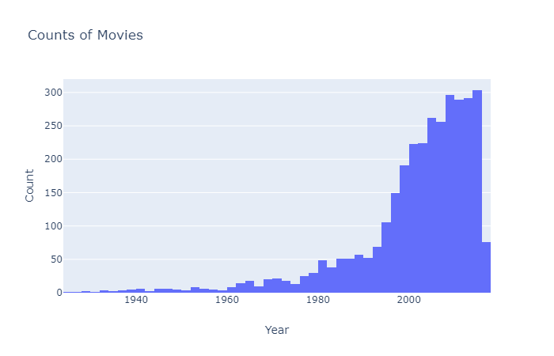
2. Exploratory Data Analysis:
Insight : we can see the year bias. we have very less movies released before 1990 as compare to movies realeased after 1990.

Slide 7
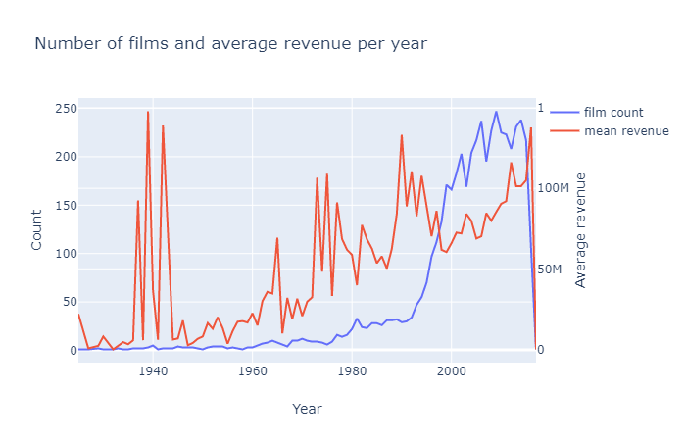
2. Exploratory Data Analysis:
Anomalies ?
Insight : In the above plot we are looking at the mean revenue of the movies per year. we can clearly see that revenue of the new movies(movies released after 1990)are alot more than the old movies(movies released before 1990) because there are less old movies in our dataset which makes mean value go high

Slide 8
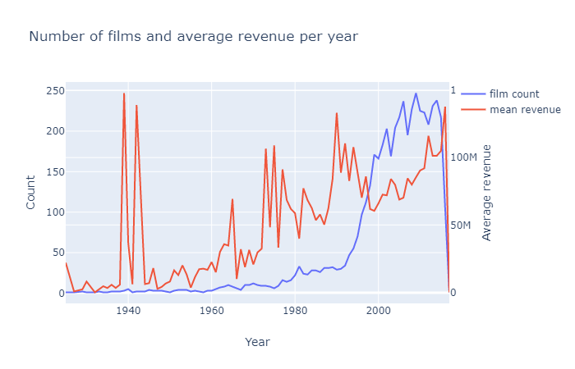
2. Exploratory Data Analysis:
Insight : After so after investigating the revenue of movie named "Snow White and the Seven Dwarfs" (1937) was incorrect. we changed it with the correct one.

Slide 9
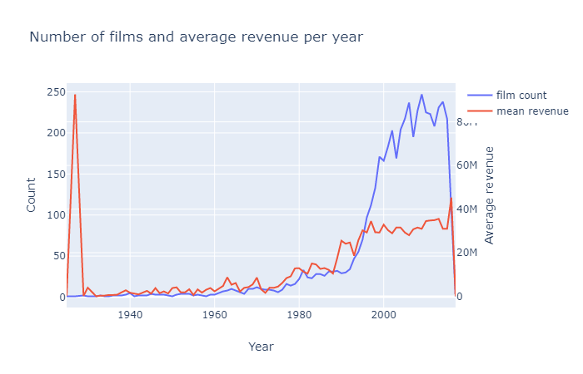
2. Exploratory Data Analysis:
Anomalies ?
Insight :The mean budget per year has gradually increased over the years. Also there is surprisingly high mean budget in 1927.

Slide 10
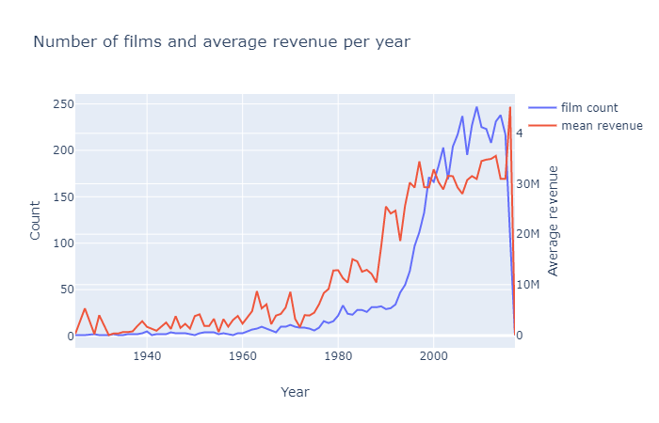
2. Exploratory Data Analysis:
Insight : After investigating there is only one movie(Metropolis) released in 1927. But, still the budget of this movie was way up high for year 1927. The budget was 92 million in 1927 which is worth 210 million today. Even movies like "World War Z"(2013), "Amazing Spider Man 2"(2014), "Transformer : Age of Extinction"(2014), "Furious 7"(2015) were made in less than 210 million.

Slide 11
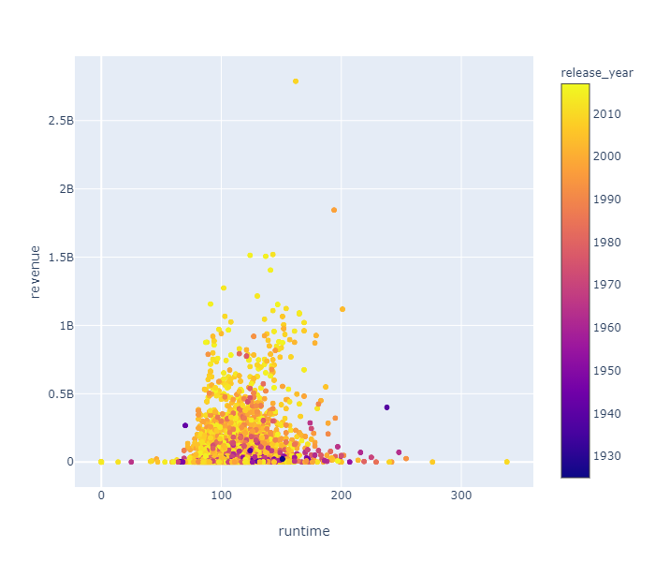
2. Exploratory Data Analysis:
Insight : There is very low linear correlation between runtime and revenue. Also runtime has not change siginificantly over the years.

Slide 12
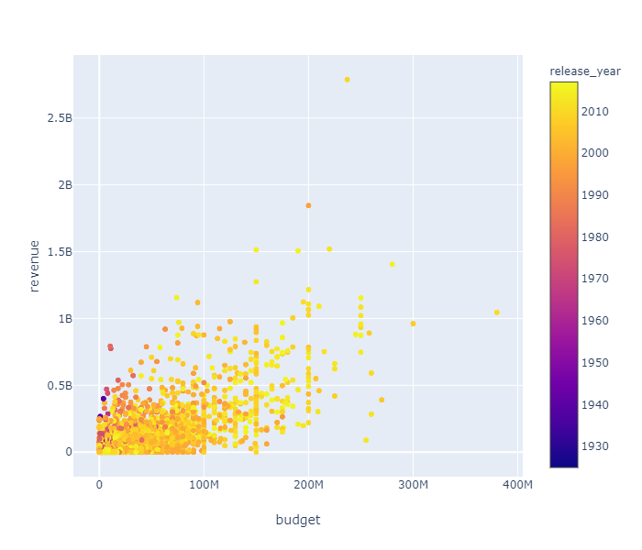
2. Exploratory Data Analysis:
Insight : There is linear relationship between budget and revenue if the budget increases then revenue also increases, But movies like "Pirates of the Caribbean : on stranger tides"(right most point on plot) had spent most but did not have highest revenue. we can also easily point out blockbuster movies(Titanic, Avatar) from the above plot based on their revenue and budget. Also most of the movies with highest budget are released around 1990 or after 2000 due to growth of film industries.

Slide 13
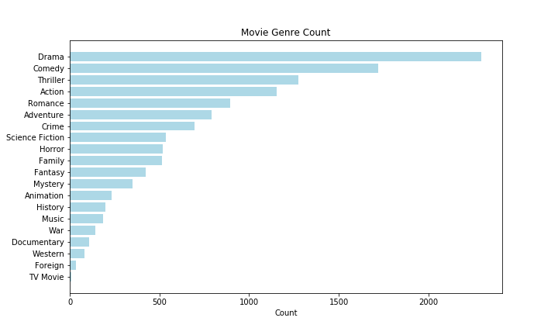
2. Exploratory Data Analysis:
Insight : we have 20 genres types in our dataset.
Top 3 genres:
Drama in : 2297 movies
Comedy in : 1722 movies
Thriller in : 1274 movies

Slide 14
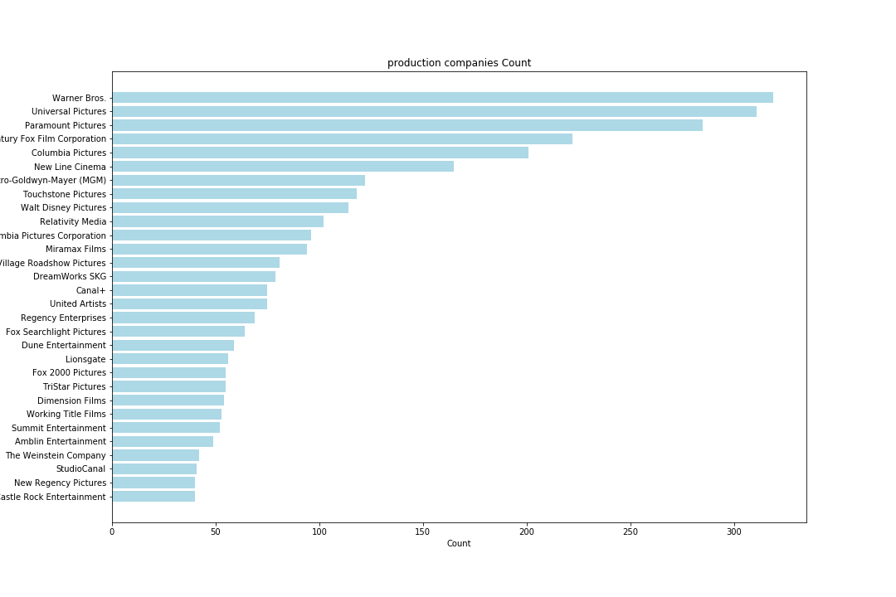
2. Exploratory Data Analysis:
Insight : we are looking at top 30 production companies out of 5017.

Slide 15
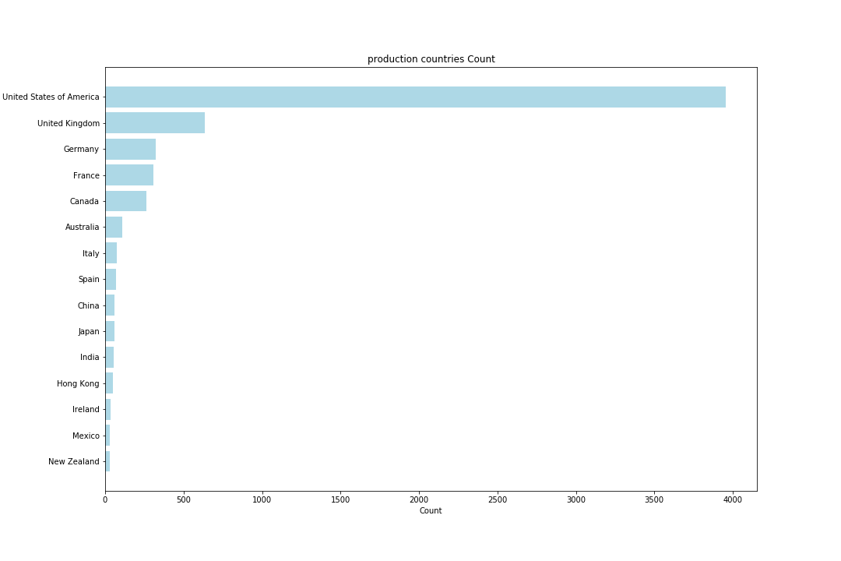
2. Exploratory Data Analysis:
Insight : we also have movies which were produced by companies from several nations. We are looking at top 15 countries out of 88.

Slide 16
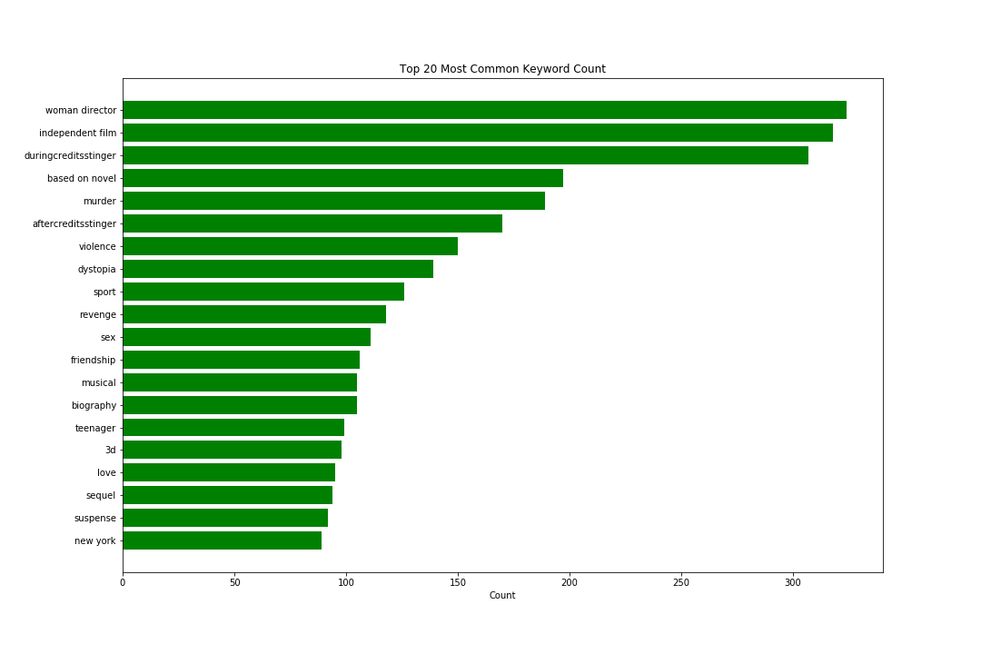
2. Exploratory Data Analysis:
Insight : keywords column describes the movies. We are looking at top 20 keywords out of 9813 in the dataset

Slide 17
3. Feature Engineering:
1. Release date :
2. Homepage :
Binned Release Year (Decade)
Release year
Release day of week
Release Date
Release day of month
Release month
Binary Format:
has homepage = 1
No homepage = 0
Homepage

Slide 18
3. Feature Engineering:
3. Original language :
4. Tagline:
5. Homepage :
Binary Format:
If English = 1
Other than English = 0
Original Language
Binary Format:
Has tagline= 1
No tagline = 0
Tagline
Numerical:
Tagline word count
Binary Format:
If English = 1
Other than English = 0
Original Language

Slide 19
3. Feature Engineering:
6. Title :
7. Overveiw :
8. Production Companies :
8. Production Countries :
Numerical :
Title word count
Title
Numerical:
Overview word count
Overview
Numerical:
Number of production
companies
Production
Companies
Numerical:
Number of production
countries
Production
Countries

Slide 20
3. Feature Engineering:
9. Spoken Languages:
10. Status :
11. genres:
12. keywords :
Numerical :
Number of spoken languages
Spoken Languages
Binary Format:
Movie released : 1
Rumored : 0
Status
One hot encoding:
20 new features for 20 genres in binary format
genres
Numerical:
Number of keywords
keywords

Slide 21
3. Feature Engineering:
13. Extra Features:
“Isholidayreleased”
Binary format :
Holiday release : 1
Other : 0
Release date
“keyspercent”
Numerical:
Range [0,100]
Keywords
From release year and runtime
Numerical:
Mean runtime by year
Numerical:
Number of clashes with the hit movies
Release Date

Slide 22
3. Feature Engineering:
13. Extra Features:
Mean Budget by Year
Median Budget by Year
Binned Budget
1 bin = 5 million
Inflated Budget Last Year
Budget
Inflated Budget Year
(ref first year)
Mean Budget by Decade
(ref first decade)
Inflated Budget by Decade

Slide 23
3. Feature Engineering:
13. Extra Features:
Budget Year Ratio
Budget to runtime
Budget, Runtime,
Release Year,
Mean Budget by year,
Mean runtime by year
Budget to mean budget by year
Runtime to mean runtime by year
Inlated Budget by Decade

Slide 24
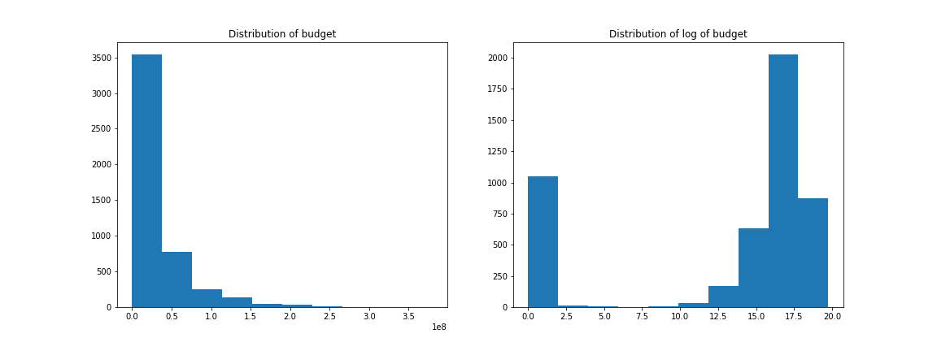
3. Feature Engineering:
13. Extra Features:
Budget
Log Budget

Slide 25
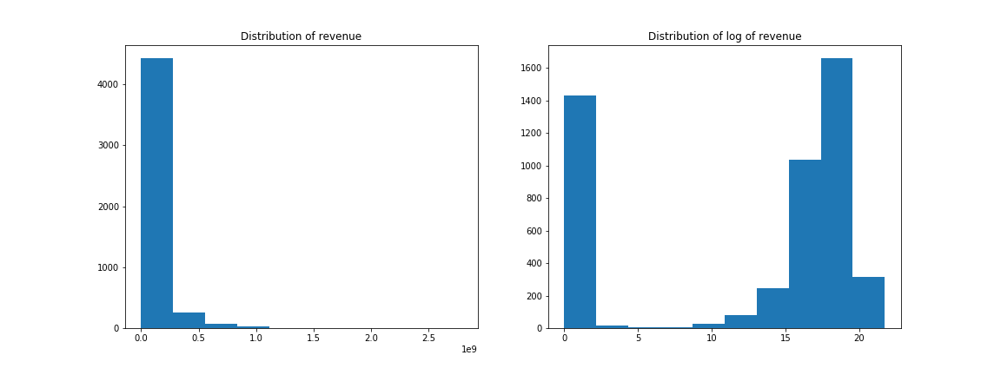
3. Feature Engineering:
13. Extra Features:
Revenue
Revenue

Slide 26
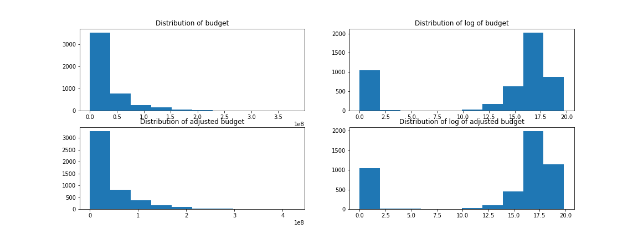
3. Feature Engineering:
13. Missed Features:
1. Adjusted Budget using customer price index : same as log transformation

Slide 27
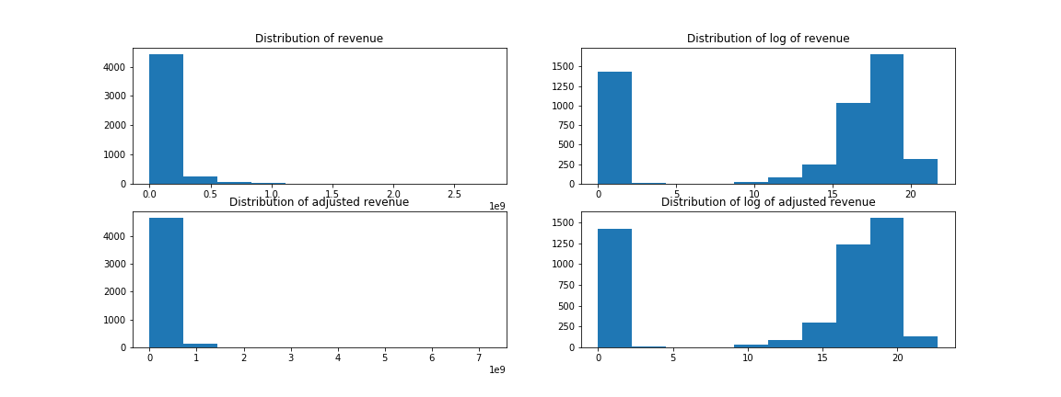
3. Feature Engineering:
13. Missed Features:
2. Adjusted Revenue using customer price index : same as log transformation

Slide 28
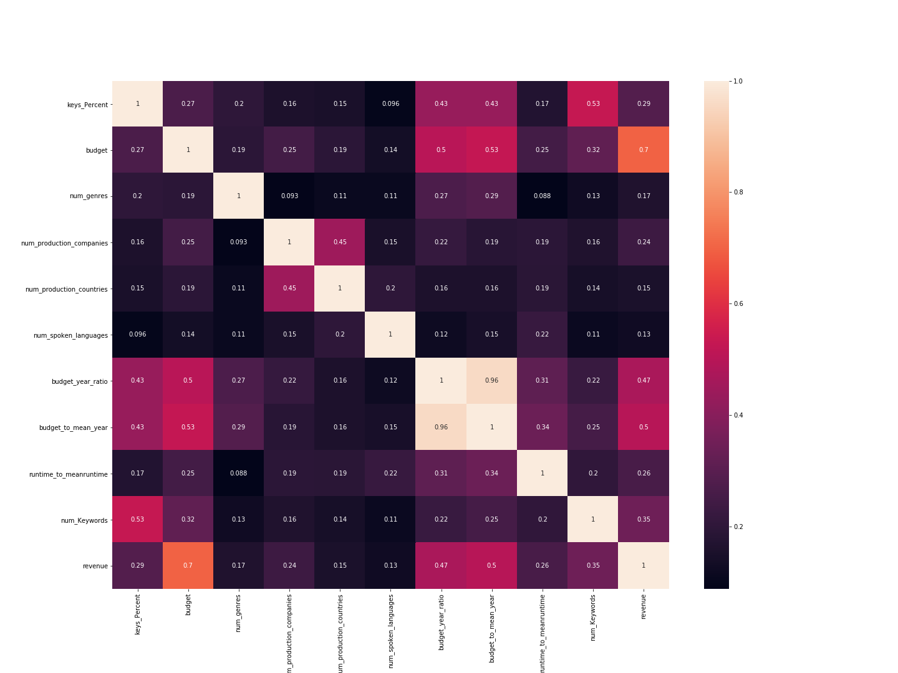
4. Feature Selection:
Numerical variables
with Pearson
correlation more
than 0.1 with
target variable

Slide 29
4. Feature Selection:
Conducted One way ANOVA test between target variable (continuous) and every flag variable that we have created in feature engineering.
Set threshold at p = 0.05 to select significant features.
Below are the list of categorical features we found significant :
Drama_genre Fantasy_genre
Comedy_genre Mystery genre
Thriller_genre Animation_genre
Action_genre War_genre
Romance_genre Documentary_genre
Adventure_genre Foreign_genre
Crime_genre TV Movie_genre
Science Fiction_genre has_homepage
Horror_genre eng_language
Family_genre is MovieReleased
Fantasy_genre USholidayreleased
we have in total 32 features(numerical + Categorical) for modelling.

Slide 30
4. Modelling:
4.1 ML models
Linear Regression
Baseline
Bayesian Optimized
Random Forest
Machine Learning Model used
XGBoost
Baseline
Bayesian Optimized
Lightgbm
Baseline
Bayesian Optimized

Slide 31
4. Modelling:
4.2 Metrics
We are using RMSLE (Root Mean Squared Logarithm Error) to evaluate the performance of the models.
RMSLE : log(Pi +1) – log(Ai + 1) = log((Pi + 1)/(Ai + 1))
Only the percentual differences matter.
For example: P = 1000 and A = 500 would give you the roughly same error as when P = 100000 and A = 50000
We are using this metric because we don’t want to penalize huge differences in the predicted and true values when both predicted and true values are huge numbers and when we have log transformation.

Slide 32
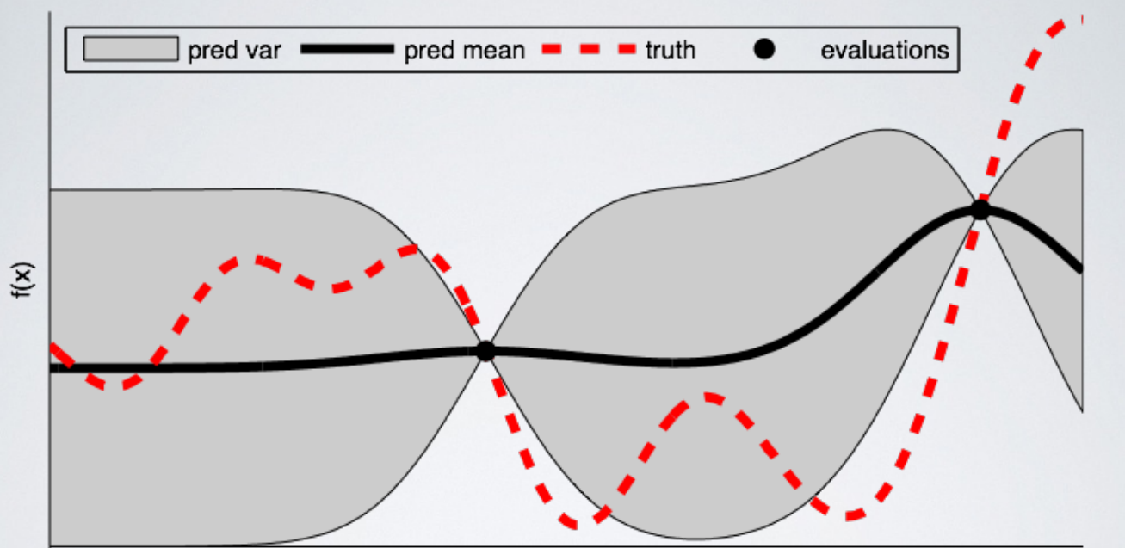
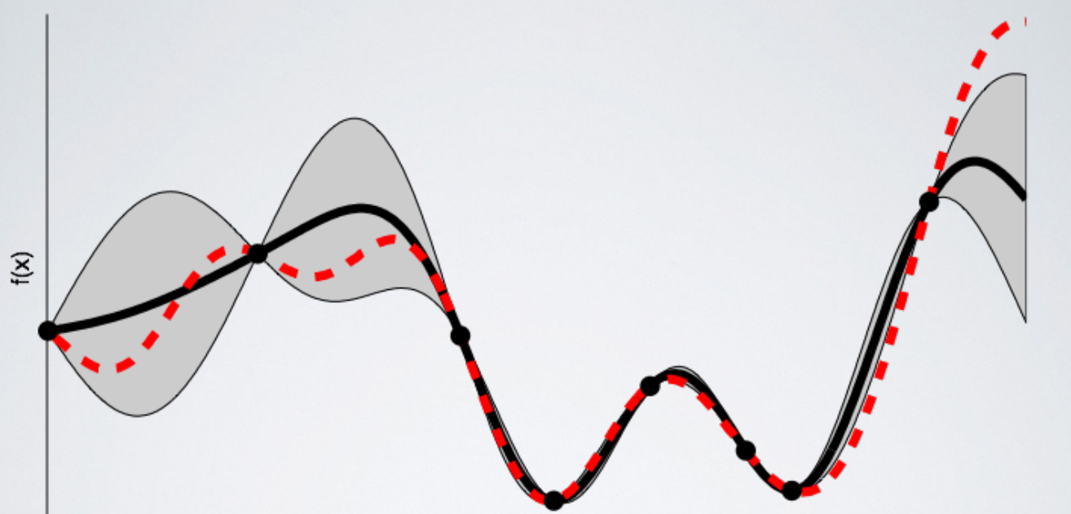
4. Modelling:
4.3 Hyperparameter technique: Bayesian Optimization
Black line : Surrogate function
Red dotted line : True Function
Gray area : uncertainty

Slide 33
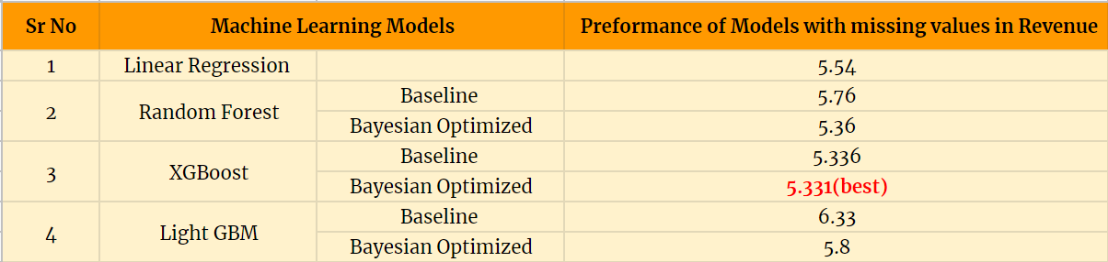
4. Modelling:
4.4 Model Performance
4.4.1 Model performance with missing values in revenue
Bayesian Optimized XGBoost model has lowest RMSE score.
When these models were trained we have around 1500 missing values in target variable which makes the data noisy and directly affects the ability of data to learn from data.
We will impute new values to replace zeros in revenue column and see if we can improve performance of the models. Before that lets take look at the feature importance.

Slide 34
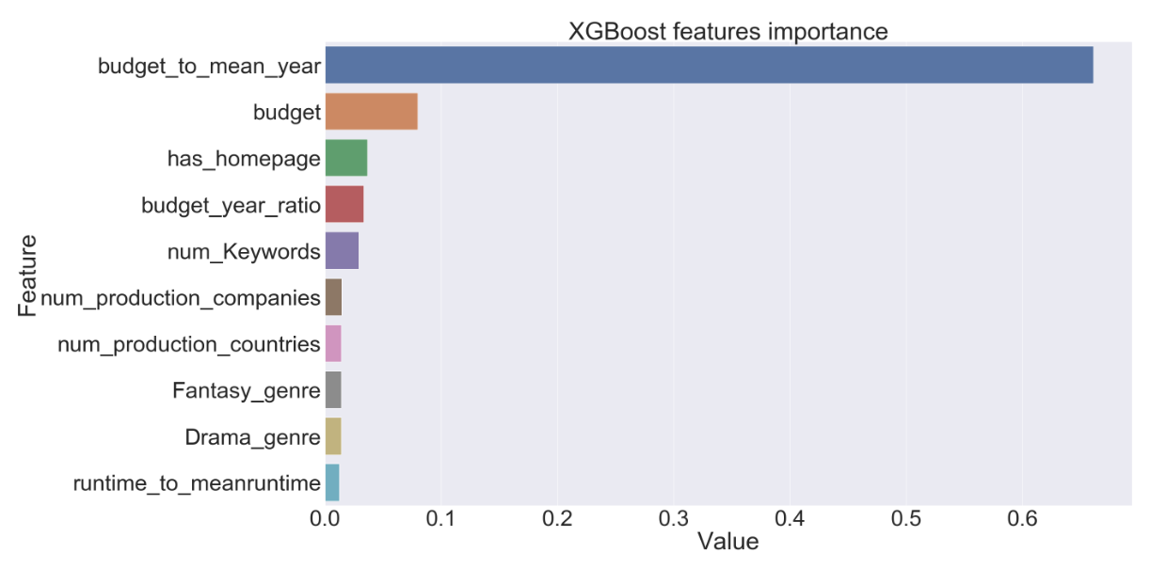
4. Modelling:
4.4 Model Performance
4.4.1 Model performance with missing values in revenue

Slide 35
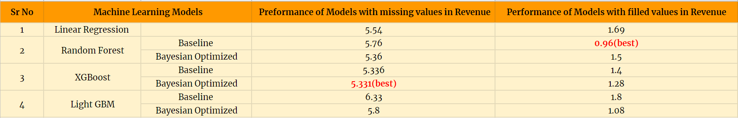
4. Modelling:
4.4 Model Performance
4.4.2 Model performance with filled values in revenue
Imputation procedure: Trained all three ML models (random forest, xgboost, Lightgbm) using observation where revenue is not equal to zero. Used the best model to predict the revenue of the observation where revenue was equal to zero.
Now using complete dataset with no missing values in target column the model performance is given below :

Slide 36
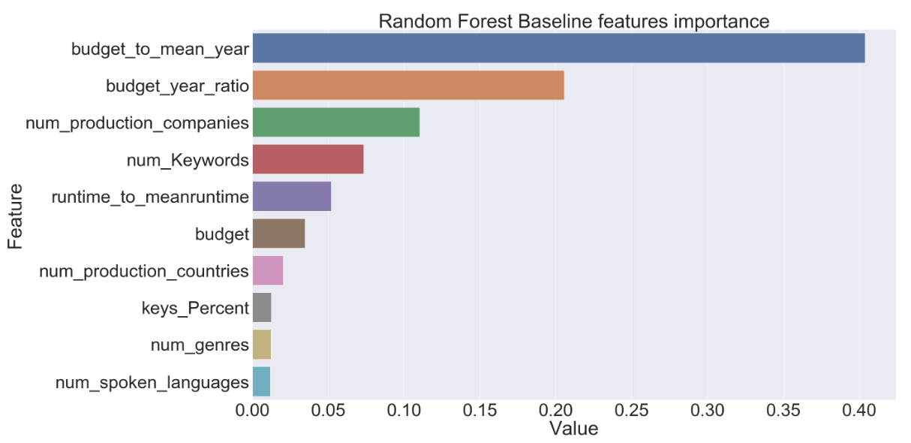
4. Modelling:
4.4 Model Performance
4.4.2 Model performance with filled values in revenue

Slide 37
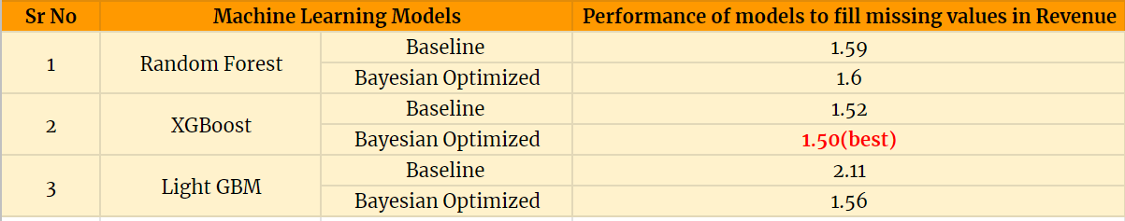
5. Summary

Slide 38
6. Conclusion
We have started this project by finding some anomalies in our dataset, created 39 new features, filtered them to 32 using correlation techniques. we have trained 4 machine learning models. XGBoost gives us best RMSE score. we see that after imputing zeros values in Target Variable there is very good improvement in the RMSE score and random forest gives us best RMSE score following with Bayesian Optimize Lightgbm.
Best Model performance with zero values in Target is : 5.331 (RMSE) Best Model performance with filled zero values in Target is : 0.96 (RMSE)
we have seen that the features like budget, number of production country involve, number of spoken languages, number of keywords, number of genres are most important in explaining our target variable (Revenue)

Slide 39
Thank you

